Slide 1

The two-equal-disjoint path cover problem of Matching Composition Network
Pao-Lien Lai , Hong-Chun Hsu
Information Processing Letters 107 (2008) 18–23
Presenter : Chih-Ying Lin
Date : Dec. 3, 2008

Slide 2
Abstract
Embedding of paths have attracted much attention in the parallel processing. Many-to-many communication is one of the most central issues in various interconnection networks. A graph G is globally two-equal-disjoint path coverable if for any two distinct pairs of vertices (u, v) and (w, x) of G, there exist two disjoint paths P and Q satisfied that (1) P (Q, respectively) joins u and v (w and x, respectively), (2) |P| = |Q|, and (3) V (P ∪ Q) = V (G). The Matching Composition Network (MCN) is a family of networks which two components are connected by a perfect matching. In this paper, we consider the globally two-equal-disjoint path cover property of MCN. Applying our result, the Crossed cube CQ_{n}, the Twisted cube TQ_{n}, and the Möbius cube MQ_{n} can all be proven to be globally two-equal-disjoint path coverable for n 5.

Slide 3
Definition
A graph G is (u, v,w, x)-two-equal-disjoint path coverable if there are two disjoint paths P and Q with end vertices u, v and w,x, respectively, such that |P| = |Q| and V (P) ∪ V (Q) = V (G).
A graph G is globally two-equal-disjoint path coverable if for any two distinct pairs of vertices (u, v) and (w, x), G is (u, v,w, x)-two-equal-disjoint path coverable.

Slide 4
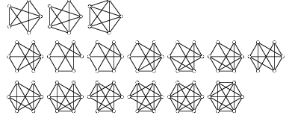
Corollary
If a graph G is globally two-equal-disjoint path coverable then G is also Hamiltonian.
Proof. Let P and Q be the (u, v,w, x)-two-equal-disjoint path cover of G such that P joins u to v and Q joins w to x where (u, x), (v,w) ∈ E(G). Then <u ,P, v, w, Q, x, u> is a Hamiltonian cycle of G.
If a graph G is globally two-equal-disjoint path coverable then G is also Hamiltonian connected.
Proof. Give any two arbitrary distinct vertices u and x of G. Let P and Q be the (u, v,w, x)-two-equal-disjoint path cover of G such that P joins u to v and Q joins w to x with (v,w) ∈ E(G). Then< u, P, v, w, Q, x> is a Hamiltonian path of G.

Slide 5
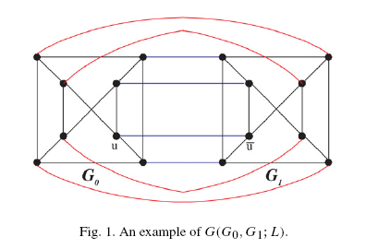
Matching Composition Network

Slide 6

Theorem : Let G₀ and G₁ be two networks with the same number of vertices N 8. Suppose that both of them are globally two-equal-disjoint path coverable. Then G(G₀ ,G₁ ; L) is also globally two-equal-disjoint path coverable.
Proof. Let (a, b) and (c, d) be two distinct source-destination pairs of G(G₀,G₁;L). In the following, we establish two disjoint paths P,Q of length N − 1 with end vertices (a, b) and (c, d), respectively. By the relative positions of the four vertices, we divide the proof
into four cases as follows.
Case 1: a and b are both in the same component G_{i} , i = 0, 1.
c and d are both in another component G_{1−i} .
Case 2: a and c are both in the same component G_{i} , i = 0, 1.
b and d are both in another component G_{1−i} .
Case 3: a, b, c and d are all in the same component G_{i} ,i = 0, 1.
Case 4: a, b and c are in the same component G_{i} , i = 0, 1. d is in another component G_{1−i} .

Slide 7
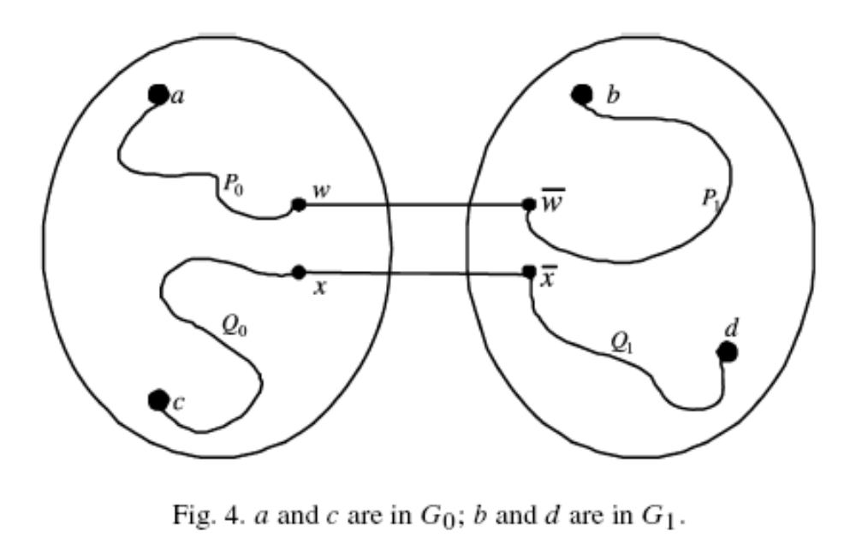
Case 2

Slide 8
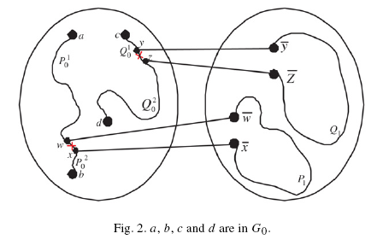
Case 3

Slide 9
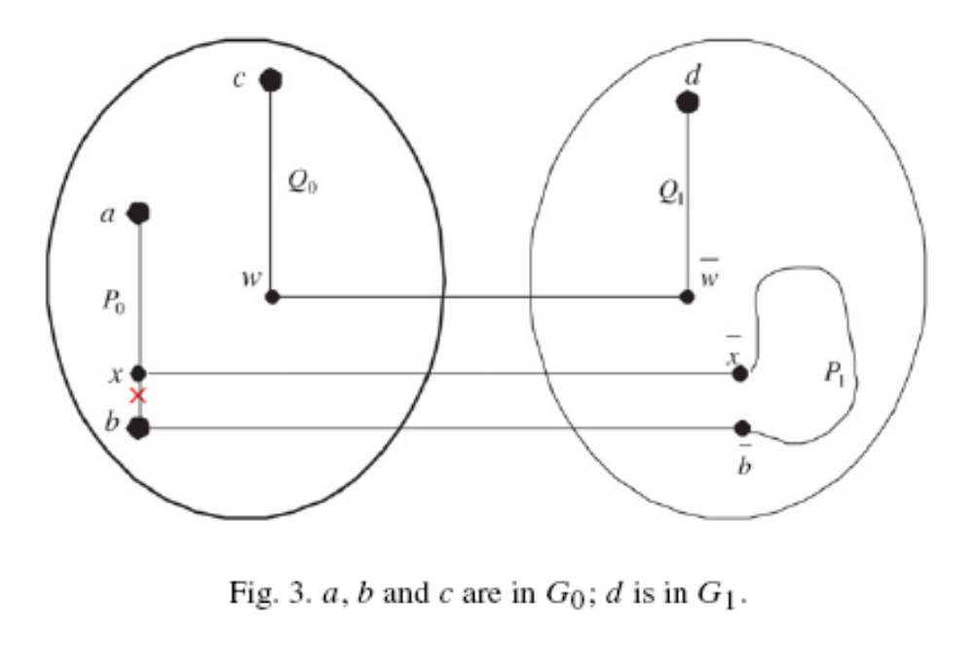
Case 4

Slide 10
Case 4 Example
a
d
b
c
x

Slide 11
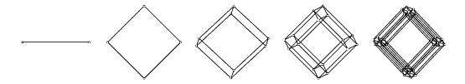
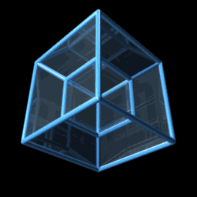
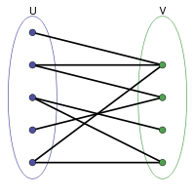
Hypercube

Slide 12
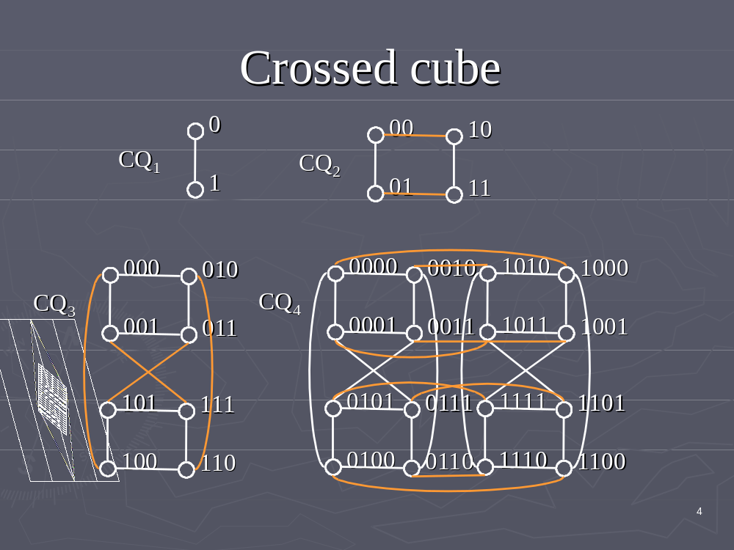

Slide 13
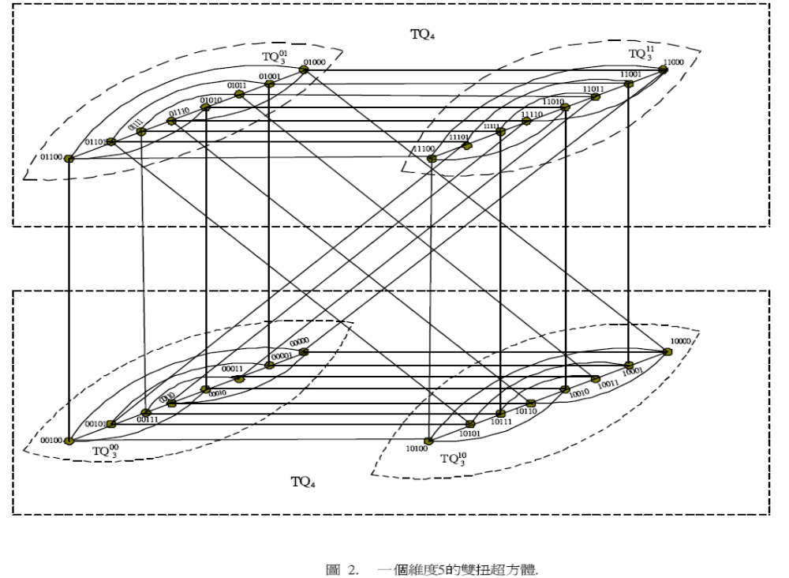
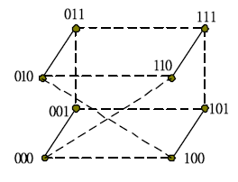

Slide 14
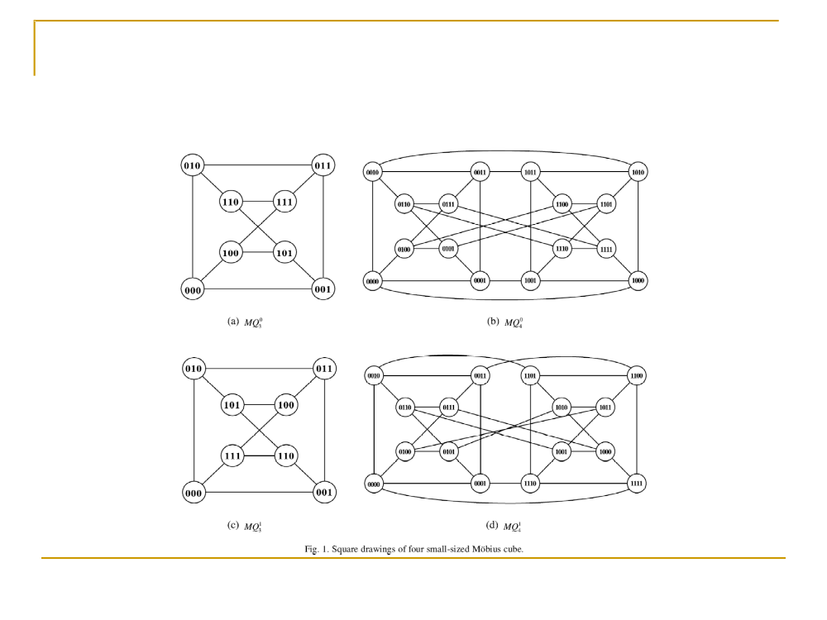

Slide 15
